Slide 1
SOCIAL MEDIA MASTERCLASS
Welcome

Slide 2
WHY SOCIAL MEDIA ?

Slide 3
Some of the reasons
You get to meet new people
There are a lot of people on social media, that means lots of possibilities
You only have to say your message once, and it goes to many people
You meet people who are already prepared to do business
You get to do your business online, it saves money.
There is an opportunity to grow my business.
I don’t have to put in much effort

Slide 4
FAcebook
Current known statistics – specific in zimbabwe
Facebook recorded 1, 799, 800 active Facebook users in Zimbabwe. This report is from February 2023
This number adds up to 9.4% of the entire Facebook community
THIS RESEARCH HAS BEEN DONE TO SHOW THAT THERE ARE A LOT OF ZIMBABWEANS ON FACEBOOK AND IT’S A PROFITABLE IDEA TO TARGET ON REACHING THIS RICH MARKET

Slide 5
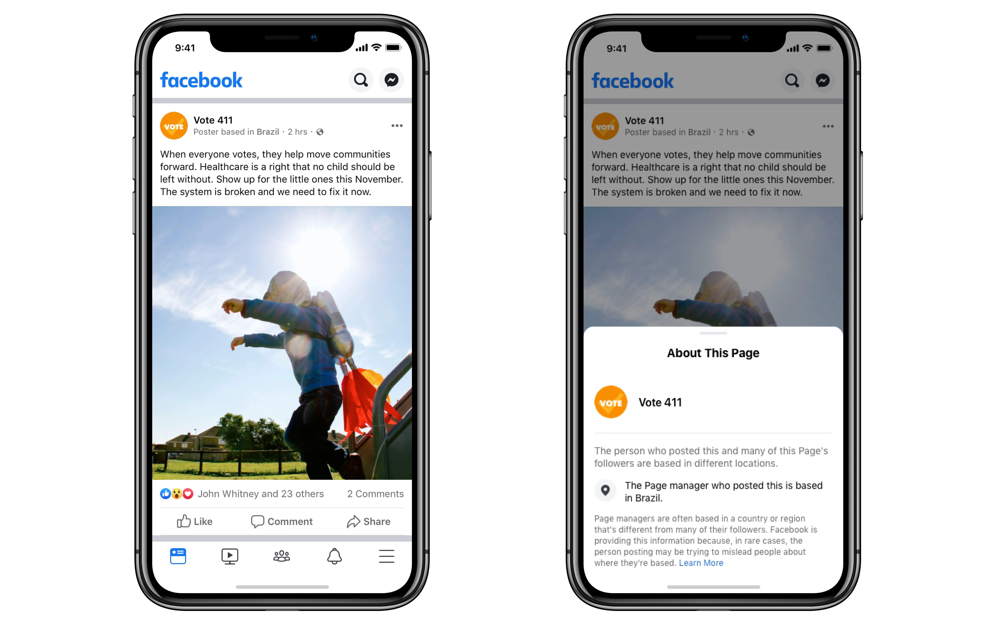
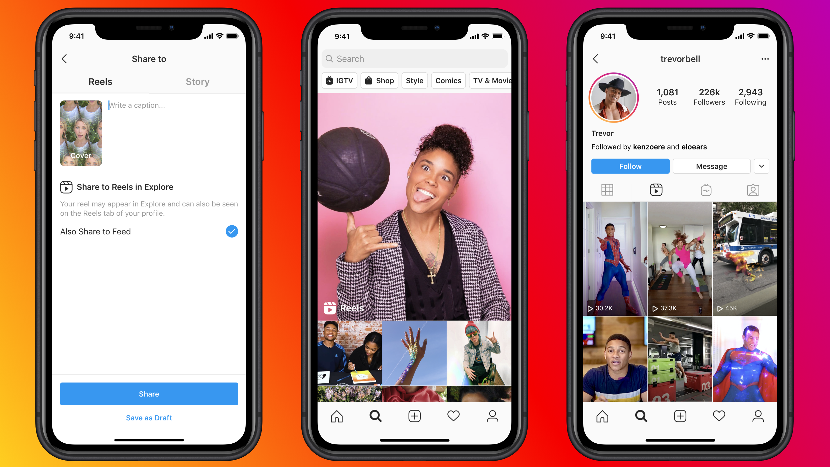
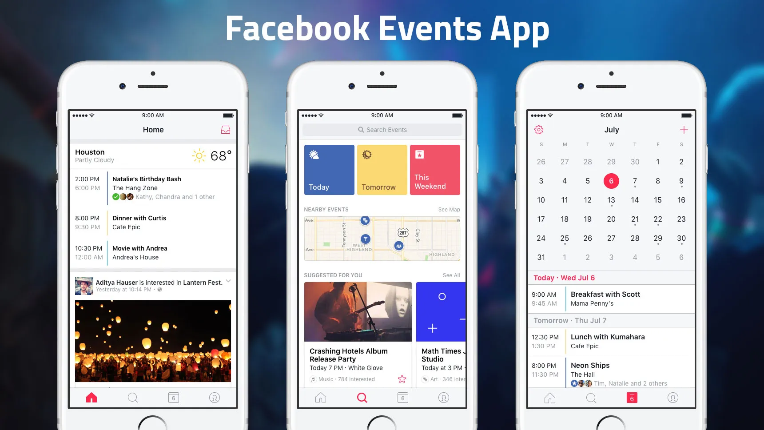
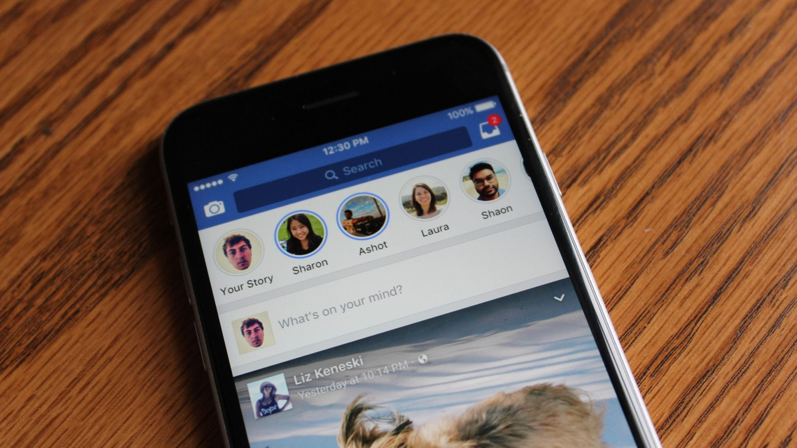
Areas to focus on
Reels
Stories
Posts
Events

Slide 6
Reels
Short, precise and informative video
Designed to grab viewers attention and make them focus more on your brand
They have a maximum limit of 90 seconds / 1 minute 30 seconds
The best way to use reels is to tell a short but interesting story about your brand or some product you will be advertising

Slide 7
stories
Stories only have the disadvantage of disappearing after 24hrs
For this reason, stories are meant to portray a singular message that is short and precise.
Talk about the current promotions that you are running
Talk about your best products or services that instantly catches people’s attention

Slide 8
posts
Posts on the other hand, they stay for as long as your Facebook page is available.
They don’t go anywhere, so do not post content that has damaging effect on your brand.

Slide 9
events

Slide 10
content

Slide 11
Color psychology

Slide 12
Static posts

Slide 13
Motion graphics

Slide 14
dimensions

Slide 15
strategy

